Slide 1

WOC7021 DISSERTATION
Candidature Defense
Program: | MCS(AC)
Matric Number: | S2164723
Name: | Wang Meng
Supervisor: | Dr. Suzan Jabbar Obaiys

Slide 2
Image and Text Fusion for Intent Detection in Multimedia

Slide 3
TABLE of CONTENTS
01
Introduction
04
Experiments Results
02
Literature Review
05
Conclusion and Future Work
03
Research Methodology
06
Proposed Publication

Slide 4
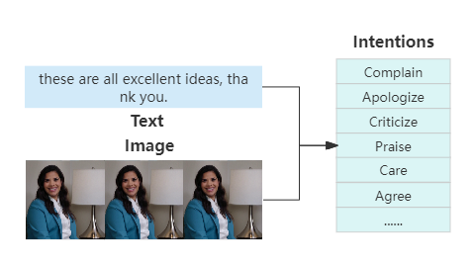
1.1. Background
As an important research direction in the fields of artificial intelligence and computer science, intent detection is one of the core technologies of human-computer interaction, aims to accurately identify the user's intent from his input to achieve more intelligent services.
An example of intent detection based on text and image fusion.

Slide 5
1.1. Background
Multimedia includes text, image, audio, video, and other forms of information expression. In recent years, the explosive growth of social media platforms has provided a wide range of dissemination platforms for multimedia content. Multimedia forms of information better meet the needs of users to express themselves, obtain information, and engage in interaction on social media. However, this expansion also brings challenges, especially in understanding and predicting user intentions in these digital spaces.
Data

Slide 6
1.1. Background
In recent years, machine learning has made remarkable progress in processing various forms of media such as images and texts. Especially, the wide application of deep learning technology provides a powerful tool for intention detection, so that the model can better learn and understand the real purpose of users from complex massive data.
Tool
Nowadays, intention detection is facing more complex and diverse user expressions. As a cutting-edge research method, multimodal data fusion, especially the fusion of image and text, provides a new idea to solve this problem. Existing research based on image-text information fusion mainly focuses on sentiment analysis and content classification, but there are still significant gaps in interpreting the subtle intentions behind user behavior.
Method

Slide 7
1.2. Problem Statement
Traditional intention detection methods are usually limited to single-modal data analysis and do not make full use of the rich information of multimedia data, and it is difficult to effectively complete the task in the face of the diversity and complexity of input content.
Existing methods for intent detection based on multimodal use multiple single-modality pre-training models for different modalities(images, texts) feature extraction, which not only increases the complexity of the system and the computational cost and may also limit the model’s comprehensive understanding of the context.
In the fusion stage of existing multimodal approach, only the global features is considered but the character-level features is ignored, which may also affect the performance of the model.

Slide 8
1.2. Problem Statement
In response to these challenges of insufficient single-modal detection capability and the limitations evident in the existing multimodal methods, this research proposes an intent detection method based on image and text fusion. It consists of two equally important stages of multimodal representation and fusion.
In the feature representation stage, we use one multimodal large-scale pre-training model to extract both image and text features simultaneously and achieve multimodal representations.
In the fusion stage, since the importance of text and pictures is not the same, we design an attention-based cross-modality multi-level fusion method, which can fuse image and text features from character-level and global level, enables the model to dynamically adjust the attention to different modalities, capture important features, and improve the performance of the model.

Slide 9
1.3. Research Questions & Objectives
Research Questions | Research Objectives
1. How can the multimodal (Vision-Language) pre-training model be leveraged for feature extraction and representation in the field of intent detection? | a. To introduce Vision-Language large-scale pre-training models to extract text and image features to achieve multimodal representation.
2. How to fuse image and text features from character-level and global-level based on attention mechanism? | b. To fuse image and text features from character-level and global-level based on cross-modal multi-level attention mechanism.
3. How can the proposed method affect the accuracy of intent detection? | c. To evaluate the performance of the proposed intent detection method by comparing its accuracy with the baseline model.

Slide 10
1.4. Research Scope & Significance
In this study, we explore the application of deep learning techniques based on image and text fusion in the intention detection of multimedia content. We verify the suitability of multimodal large-scale pre-training models in feature extraction and the effectiveness of multi-level attention mechanisms in feature fusion by comparative experiment.
Intent detection plays a crucial role in enhancing human-computer interaction by accurately interpreting user intentions. By effectively integrating information from various media can improve the accuracy. This multimodal approach allows intelligent systems to understand user needs more comprehensively, leading to more flexible and natural interactions.

Slide 11
TABLE of CONTENTS
01
Introduction
04
Experiments Results
02
Literature Review
05
Conclusion and Future Work
03
Research Methodology
06
Proposed Publication

Slide 12
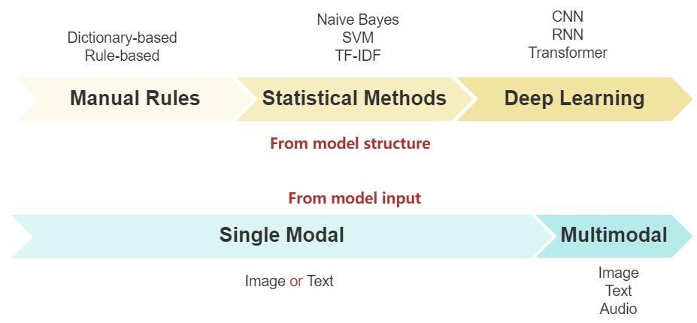
2.1. Intention Detection

Slide 13
2.1. Intention Detection
Title | Modality | Method | Pros | Cons
Manual Rules
Finding suggestions and buy wishes from product reviews (Ramanand et al. 2010) | Text | Rules Graphs | easy to realize, fast operation speed | high workload, poor stability
Statistical Learning Method
Intent Detection through Text Mining and Analysis (Kruk et al. 2019) | Text | SVM | Automatic pattern, learning Process big data | low efficiency, Manual feature extraction
Deep Learning
Intent recognition model based on sequential information and sentence features (Wu et al. 2024) | Text | CNN BILSTM BERT | Automatic feature extraction and pattern learning | Only text, low efficiency
An effective multimodal representation and fusion method for multimodal intent recognition (Huang et al. 2023) | Text Image Audio | Attention BERT Faster-CNN Wav2vec | High stability, High performance, Accommodate large relations | More complex, Higher computational and storage resources

Slide 14
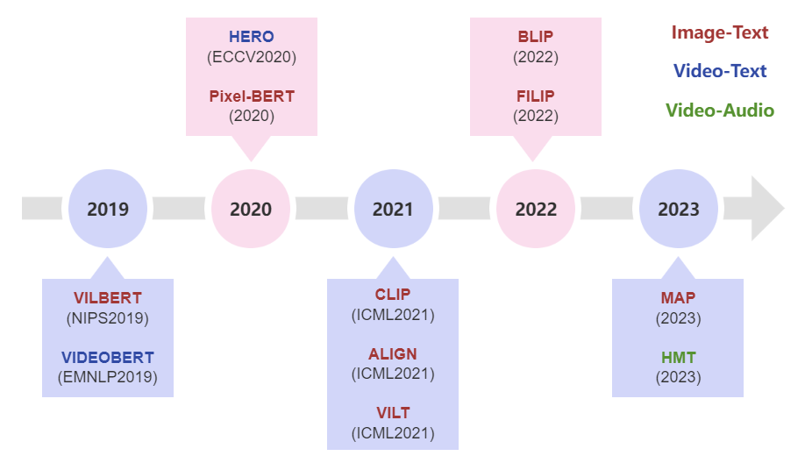
2.2. Multimodal Pre-training

Slide 15
2.2. Multimodal Pre-training
Title | Modality | Model | Task | Performance
VAuLT: Augmenting the Vision-and-Language Transformer for Sentiment Classification on Social Media (Georgios et al. 2023) | Text + Image | VILT | Sentiment Classification | TWITTER-15: acc=75.0 (+1.8) mac-F1=69.0 (+1.9) TWITTER-17: acc=67.8 (+0.5) mac-F1=64.9 (+3.8)
ViLBERT combined with multi-modal knowledge graphs attention network for news recommendation (Zeyu et al. 2023) |  | ViLBERT | News Recommendation | Chinese news: Recall=0.3865 (+2.3%) ndcg=0.3585 (+3.0%) English News: Recall=0.4126 (+2.6%) ndcg=0.3623 (+2.9%)
Exploiting CLIP-based Multi-modal Approach for Artwork Classification and Retrieval (Alberto et al. 2023) |  | CLIP | Image Classification and Retrieval | Classification: acc=83.56 (+6.42) mAP=72.23 (+8.52) Retrieval: mAP=69.60 (+15.39)
Hierarchical multimodal transformer to summarize videos (Bin et al. 2023) | Video + Audio | HMT | video summarization | SumMe: F-measure=0.441 (+0.021) TVsum: F-measure=0.601 (+0.016)
Multimodal Intent Discovery from Livestream Videos (Adyasha et al. 2022) | Video + Text | HERO | Intent Discovery | Tool Intents: F=0.62 (+0.02) Creative Intents: F=0.3 (0.03)

Slide 16
TABLE of CONTENTS
01
Introduction
04
Experiments Results
02
Literature Review
05
Conclusion and Future Work
03
Research Methodology
06
Proposed Publication

Slide 17
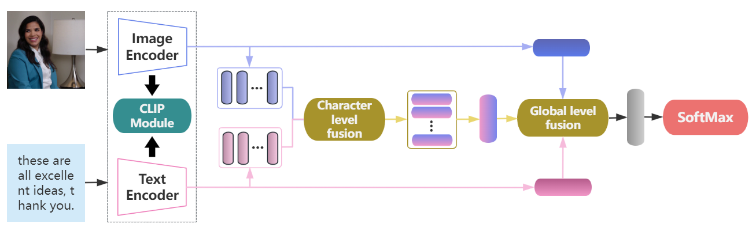
3. Research Methodology
Representation
Fusion
Classification
Intent detection architecture diagram

Slide 18
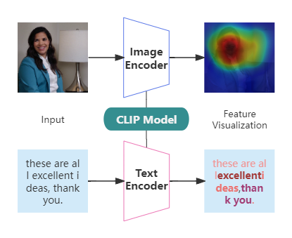
3.1. Multimodal Representation
CLIP (Contrastive Language–Image Pre-training)
Released by OpenAI
Trained over 400 million image-text pairs
Can process image and text
Adopt Vision Transformer (ViT) and the Text Transformer (Bert)
Include 1.7 billion parameters
Highly efficient, flexible and general
Automatically align text and images
Feature representation based on CLIP

Slide 19
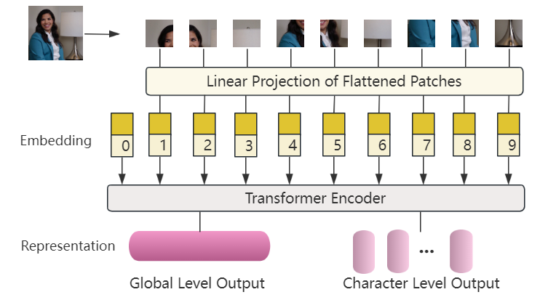
3.1. Multimodal Representation
Image Encoder
First, divide the image into patches and linearly transform each patch to obtain input vectors.
Then, add positional information to consider the sequence of inputs.
In Transformer Encoder, calculate weights and output using self-attention mechanism.
Output global-level and character-level features .
Vision Transformer architecture diagram

Slide 20
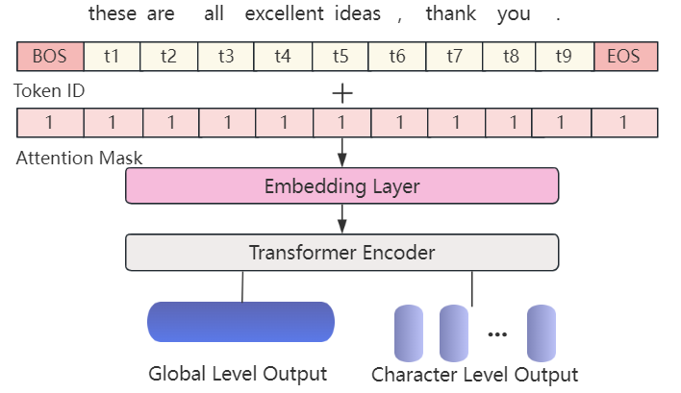
3.1. Multimodal Representation
Text Encoder
Tokenize input text into tokens, embedding layer transforms each token into an embedding vector.
Apply multiple transformer encoder blocks to process the token embeddings and positional encodings.
Aggregate the output embeddings of the transformer blocks.
Output global and character-level features .
Text Transformer architecture diagram

Slide 21
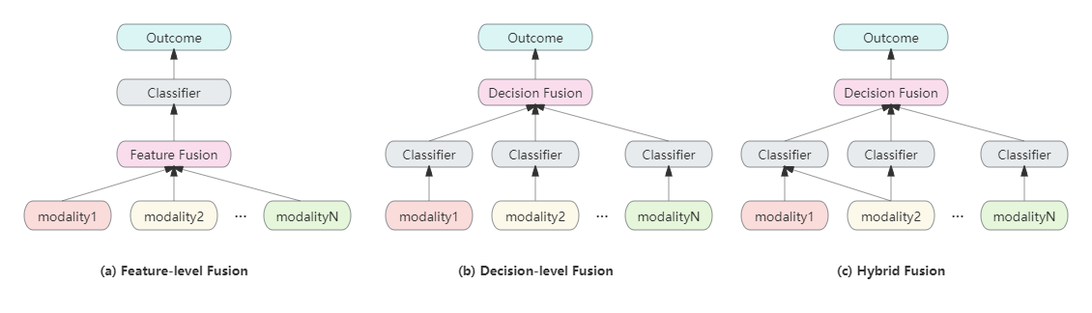
3.2. Multimodal Fusion
Three different fusion strategies
can adjust the attention between modalities based on attention mechanism to achieve more effective information fusion
cannot well capture the interaction information between different modalities
is relatively complex, difficult to implement, can easily cause over-fitting problems, and is suitable for scenarios with three modalities and above

Slide 22
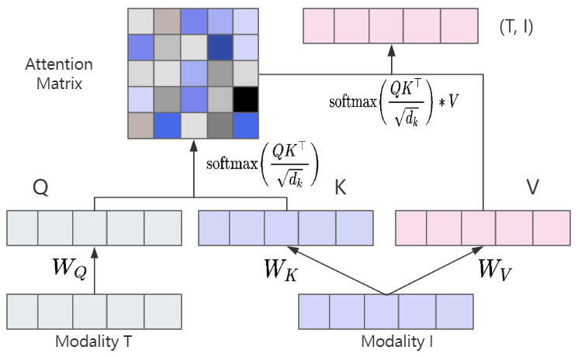
3.2. Multimodal Fusion
For the image "I" and text "T" , calculate Queries "Q" , Keys "K" , and Values "V"
Text to Image Attention: calculate attention scores by taking the dot product of Image Key (K_I) and Text Query (Q_T), then apply SoftMax for normalization
Weighted sum of Image Values (V_I)
Cross-attention calculation process

Slide 23
TABLE of CONTENTS
01
Introduction
04
Experiments Results
02
Literature Review
05
Conclusion and Future Work
03
Research Methodology
06
Proposed Publication

Slide 24
4.1. Dataset
First Level | Second Level | Number of samples
Express emotions and attitudes | Complain | 286
 | Praise | 213
 | Apologize | 136
 | Thank | 124
 | Criticize | 117
 | Care | 95
 | Taunt | 62
 | Agree | 59
 | Flaunt | 52
 | Oppose | 51
 | Joke | 51
Achieve goals | Inform | 284
 | Advise | 122
 | Arrange | 110
 | Introduce | 105
 | Comfort | 88
 | Leave | 85
 | Prevent | 73
 | Greet | 60
 | Ask for help | 51
Num of total labels: 20
Num of total samples: 2224
Proportion of division : 6:2:2
Item | Number of samples
Train | 1,334
Valid | 445
Test | 445

Slide 25
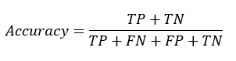
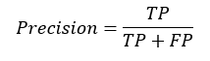
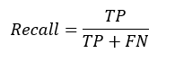
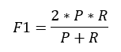
4.2. Evaluation Metrics & Implementation Details
Through observation of test results and based on prior knowledge, we set main parameters as follows:
Name | Value
Batch Size | 16
Epoch | 15
Learning Rate | 1.00E-05
Optimizer | Adam
Loss Function | Cross Entropy
Activation Function | ReLu
Dropout Rate | 0.2
Early Stop | 8
Text Dimensions | 512
Image Dimensions | 512
(Macro-F1)

Slide 26
4.3. Experiments on Intent Detection
Methods | Modalities | ACC | F1 | P | R
ResNet-50 | Image | 17.3 | 7.98 | 8.1 | 7.87
Trans_TAV | Text + Image | 69.44 | 67.06 | 66.7 | 67.43
BERT | Text | 69.89 | 67.2 | 67.16 | 67.25
MulT | Text + Image | 71.24 | 67.85 | 68.32 | 67.39
MAG-BERT | Text + Image | 71.69 | 68.59 | 69.36 | 67.83
OURS* | Text + Image | 71.91 | 68.59 | 69.44 | 67.77
The above table shows the overall comparative experimental results. from the perspective of overall metrics, our approach shows excellent performance on the intent detection dataset compared with baseline models, which verifies the effectiveness of the proposed method.

Slide 27
4.4. Ablation Study
As can be seen from the first two rows, after removing text, only using image data has the worst effect, this shows that text features play an important role in intent detection, and the role of image information is mainly to extend text information. It can be seen from the third row that it will affect the performance of model if we do not consider the correlation between modalities during feature representation. from forth row, we can see that using only traditional vector splicing method in fusion stage is hard to effectively utilize the most relevant parts of each modality.
Model | ACC | F1 | P | R
- Text | 16.63 | 7.65 | 7.86 | 7.45
- Vision | 68.99 | 66.78 | 66.21 | 67.36
- CLIP | 70.11 | 67.14 | 67.09 | 67.19
- CAF | 68.76 | 66.69 | 66.08 | 67.32
OURS* | 71.91 | 68.59 | 69.44 | 67.77

Slide 28
4.5. Influence of Encoders
Through experiments, it was found that different encoders will slightly affect model performance, but the overall difference is not obvious. In general, smaller patches can capture more fine-grained image features, but the actual effect mainly depends on the specific tasks and datasets.
Encoder | ACC | F1 | P | R
CLIP-RN50x16 | 70.56 | 67.92 | 67.9 | 67.95
CLIP-ViT32 | 71.46 | 68.25 | 69.18 | 67.34
CLIP-RN50x64 | 71.69 | 68.53 | 69.4 | 67.69
CLIP-ViT16 | 71.91 | 68.59 | 69.44 | 67.77

Slide 29
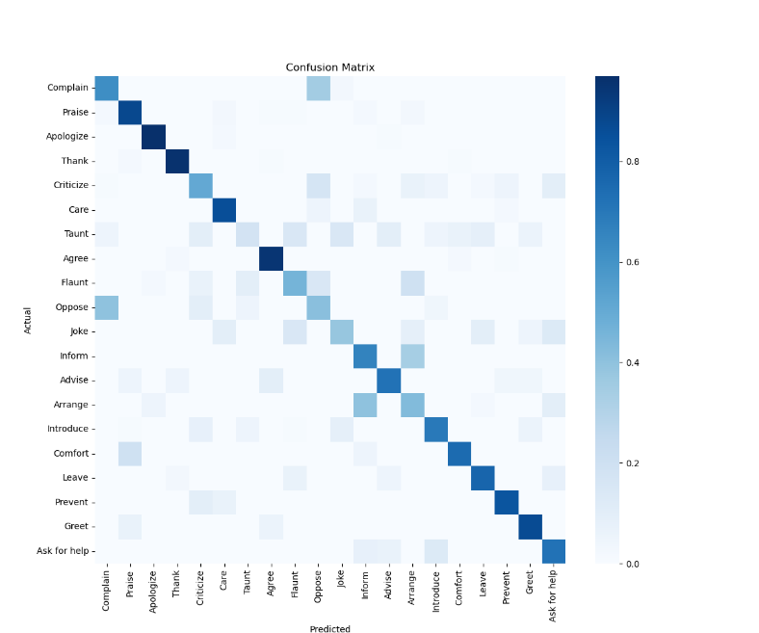
4.6. Error Analysis
Overall, the model shows high accuracy in most categories, but there are also obvious differences in the performance of different intentions. Some intentions have relatively fixed expression patterns and specific contents, such as Praise, Thank, Apologize, Agree, and Greet, and the model shows better performance in these categories. However, in some complex scenarios, such as Inform and Joke, the model performs generally, which may be because the expressions of these intentions are diversified, and the content is relatively abstract. It can be seen from the confusion matrix that the model is easy to confuse Inform and Arrange, Complain and Oppose. These categories themselves have high similarity, which is easy to cause misjudgment.

Slide 30
TABLE of CONTENTS
01
Introduction
04
Experiments Results
02
Literature Review
05
Conclusion and Future Work
03
Research Methodology
06
Proposed Publication

Slide 31
5. Conclusion
Fulfillment of Research Objectives
This research mainly explores the application of image-text information fusion technology in multimedia intent detection. In order to better utilize the information of these two different modalities, we
introduce Vision-Language large-scale pre-training models to extract text and image features to achieve multimodal representation (Research Objective 1)
fuse image and text features from token-level and global level based on cross-modal multi-level attention mechanism (Research Objective 2)
verify the effectiveness of the proposed method by comparative experiments with the baseline model on the same dataset (Research Objective 3)

Slide 32
5. Conclusion
Limitations and Future Work
Data Size and Diversity: The size and diversity of training samples is crucial to enhance model robustness and performance, the quantity of total samples used in this research is relatively small compared to the number of labels.
Add other modalities: Only the text and image are used in this research, there are other forms of modality in multimedia like audio and video, these modalities may provide extra information.
Missing modality: It is common that partial modality is missing in real world, this may affect the robustness of the model in practical application.
In conclusion, Addressing these limitations is of great significance for the practical application of the model, also is a possible research direction in the future.

Slide 33
TABLE of CONTENTS
01
Introduction
04
Experiments Results
02
Literature Review
05
Conclusion and Future Work
03
Research Methodology
06
Proposed Publication

Slide 34
6. Proposed Publication
Title: Image and Text Fusion Approach for multimodal representation and Intent Prediction
Conference Information :
Name: Nonlinear Science and Complexity
Program: Complexity Theory, Mathematical Sciences and Applied Complexity Science
Date and Place: August 5-10, 2024, Yibin, Sichuan, China
Conference Link: https://nsc2024.nscconf.org/program/
The draft paper will also be submitted to proper Journal by June 2024

Slide 35
7. References
LeCun, Y., Bengio, Y., & Hinton, G. (2015). Deep learning. nature, 521(7553), 436-444.
Schmidhuber, J. (2015). Deep learning in neural networks: An overview. Neural networks, 61, 85-117. [3] Chen, T., Liu, B., Yang, M., Liu, C., & Chang, M. C. (2018). The state of the art of deep learning in language processing. ACM Transactions on Information Systems (TOIS), 37(4), 1-43.
Baltrušaitis, T., Ahuja, C., & Morency, L. P. (2018). Multimodal machine learning: A survey and taxonomy. IEEE transactions on pattern analysis and machine intelligence, 41(2), 423-443.
Huang, X., Ma, T., Jia, L., Zhang, Y., Rong, H., & Alnabhan, N. (2023). An Effective Multimodal Representation and Fusion Method for Multimodal intention detection. Neurocomputing, 126373.
Obuchowski, A., & Lew, M. (2020, April). Transformer-capsule model for intention detection (student abstract). In Proceedings of the AAAI conference on artificial intelligence (Vol. 34, No. 10, pp. 13885-13886).

Slide 36
Thank You for Your Listening
Question and Answer

